Slide 1


Pedal - Cycling Unit
INFO 6210 - Project Team 18
Abhishek Satbhai
Chinmayi Shaligram
Gayatri Degaonkar
Mohammed Umair Ul Hasan
Pavan Pati

Slide 2

Why Pedal ?
Key Objectives Business Problems Addressed
Centralized cycling system
Eco-friendly way of transportation
Bicycle owners can contribute
Cost efficient
Avail benefits of various discounts offered

Slide 3
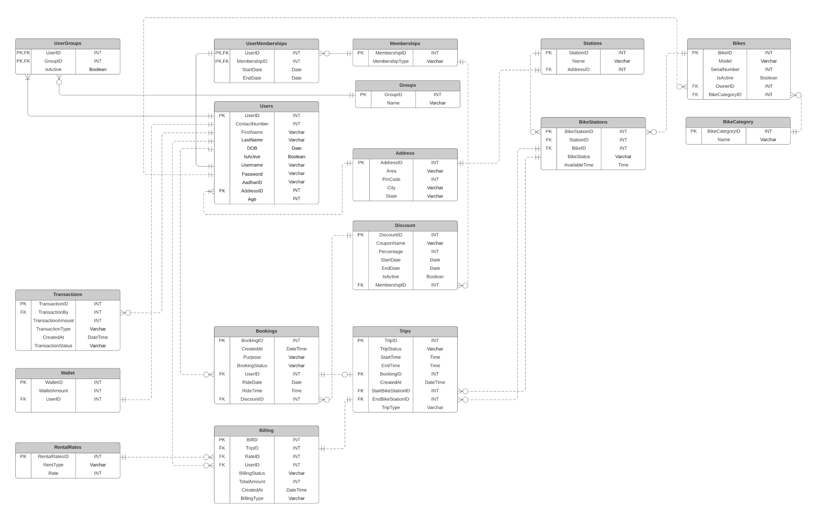

ERD
Bikes and Stations
Bookings and Trips

Slide 4
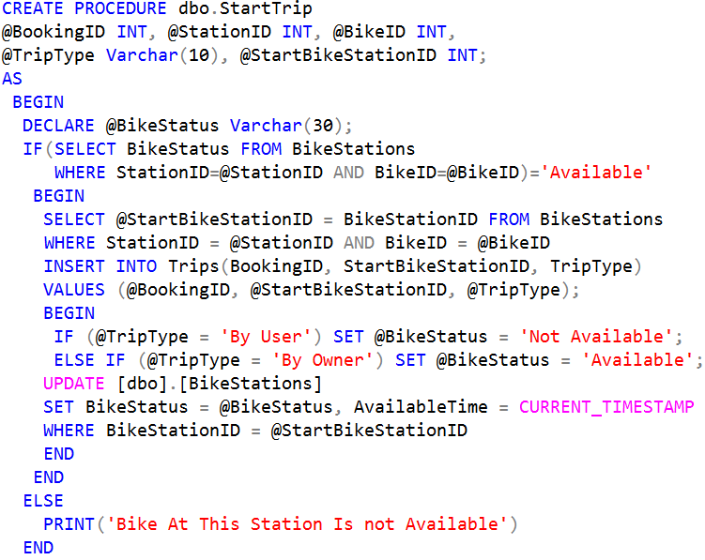
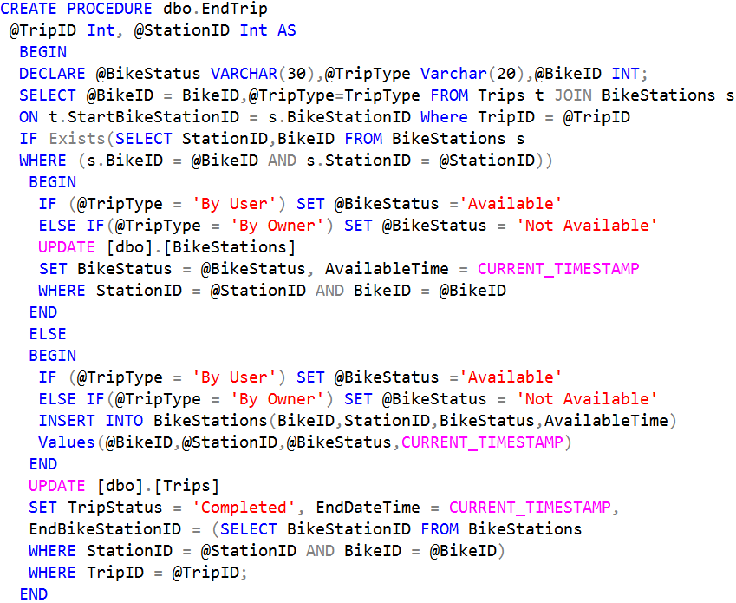
Stored Procedures
# SP for Start Trip
# SP for End Trip

Slide 5
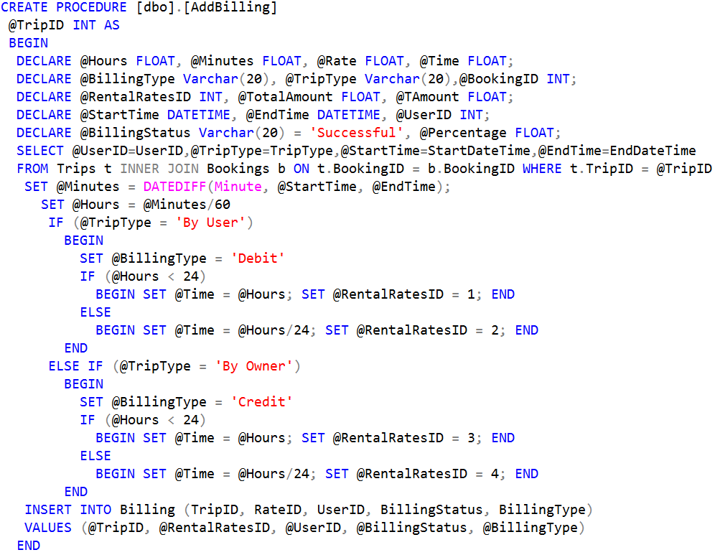
Stored Procedures
# SP to determine Time and Rate for Billing

Slide 6
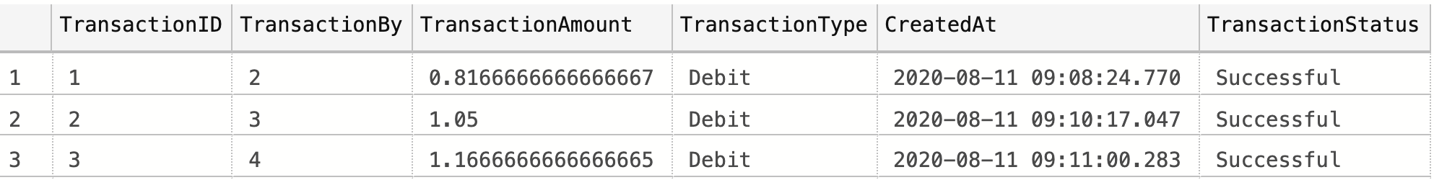
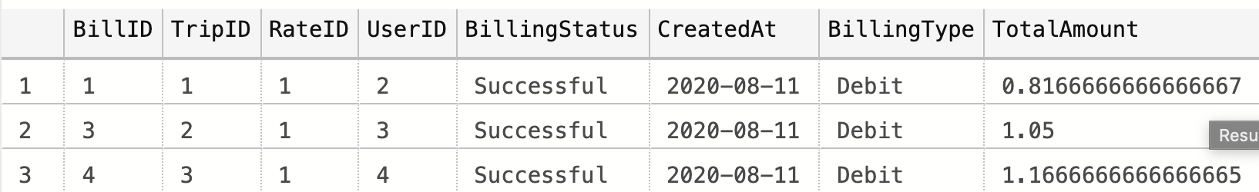
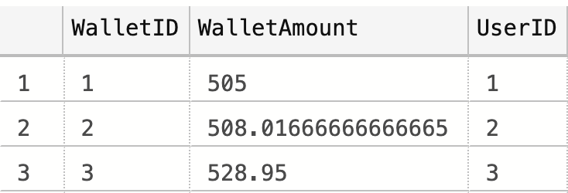
Automation
End Trip
Billing
Transactions
Wallet
Bills are generated after trip Ends, according to Trip time and Rent type.
Transactions for Users/Owners are recorded after generating Bills.
Bill Amount is debited/credited to Wallet.

Slide 7
Triggers
# Trigger for Billing automation
CREATE Trigger [dbo].[AfterEndTrip]
ON Trips
AFTER UPDATE
AS
BEGIN
DECLARE @LatestEndedTripID INT;
SELECT TOP 1 @LatestEndedTripID = inserted.TripID
FROM inserted
EXECUTE [dbo].[AddBilling] @LatestEndedTripID;
END
# Trigger for Booking Cancellation and Wallet constraints
CREATE TRIGGER [dbo].[AfterBookingUpdates]
ON Bookings
AFTER INSERT,UPDATE
AS
BEGIN
DECLARE @WalletAmount FLOAT
DECLARE @BookingStatus Varchar(30)
DECLARE @TransactionBy INT
DECLARE @TransactionAmount FLOAT
DECLARE @TransactionType Varchar(20)
DECLARE @BookingID INT
Select @WalletAmount= [WalletAmount] FROM [Wallet] WHERE UserID =
(SELECT inserted.UserID FROM inserted)
IF EXISTS (SELECT inserted.BookingID FROM inserted) AND EXISTS
(SELECT deleted.BookingID FROM deleted)
BEGIN
SELECT @BookingStatus=[BookingStatus], @TransactionBy=[UserID]
FROM Bookings WHERE BookingID = (SELECT inserted.BookingID FROM inserted)
IF @BookingStatus = 'Cancelled'
EXECUTE dbo.AddTransactions @TransactionBy,@TransactionAmount=10,
@TransactionType = 'Debit';
END
ELSE
BEGIN
IF @WalletAmount < 500
BEGIN
ROLLBACK TRAN
RAISERROR('Booking Failed ! Wallet Amount is less than 500,
add money to your wallet',16,1)
END
END
END
# Trigger For Automating Transaction and Wallet Amount
CREATE Trigger [dbo].[AfterBillingUpdates]
ON Billing
AFTER INSERT
AS BEGIN
DECLARE @LatestBillingID INT;
DECLARE @TransactionBy INT;
DECLARE @TransactionAmount FLOAT;
DECLARE @TransactionType Varchar(20);
SELECT TOP 1 @LatestBillingID = inserted.BillID
FROM inserted
SELECT @TransactionBy= [UserID],
@TransactionAmount=[TotalAmount],
@TransactionType = [BillingType]
FROM Billing WHERE BillID = @LatestBillingID
EXECUTE dbo.AddTransactions @TransactionBy,
@TransactionAmount, @TransactionType ;
END

Slide 8
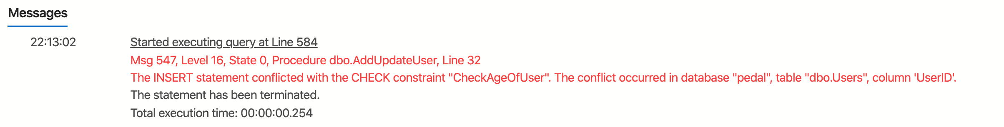
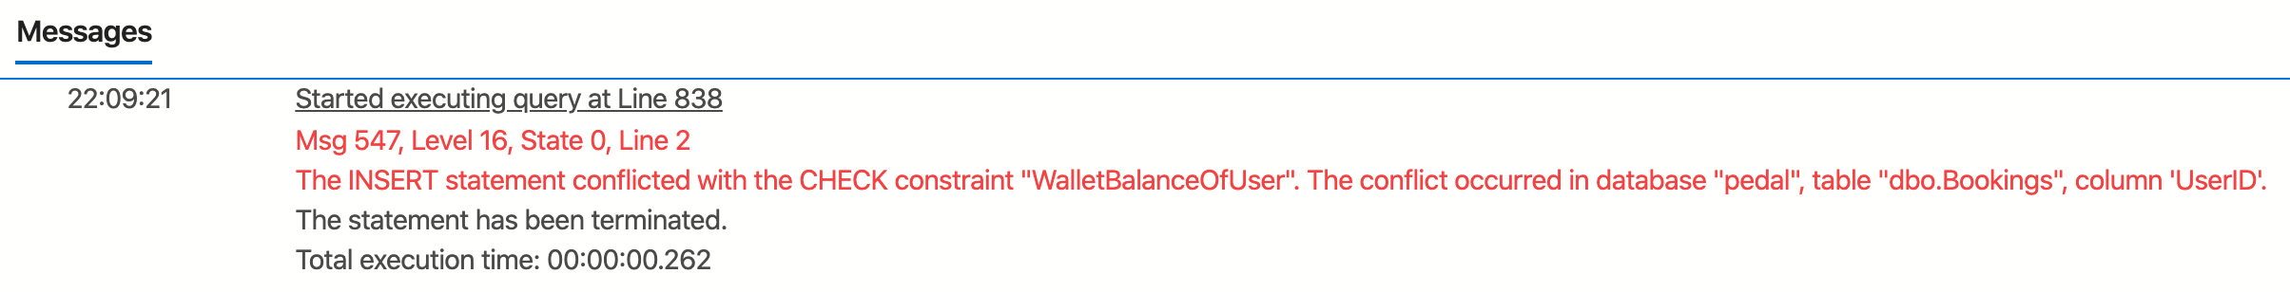
Table Level Check
# For validation user has wallet amount more than
500/- at the time of booking
CREATE FUNCTION WalletBalanceCheck (@UserID INT)
RETURNS FLOAT
AS
BEGIN
DECLARE @Balance FLOAT;
(SELECT @Balance = WalletAmount FROM dbo.Wallet
WHERE UserID = @UserID)
RETURN @Balance
END;
# Check user has age greater than 14 at the time of registration
CREATE FUNCTION CheckAge (@UserID INT)
RETURNS INT
AS
BEGIN
DECLARE @Age INT;
SET @Age = dbo.CalculateAge(@UserID)
RETURN @Age
END;
# Adding Contraints
ALTER TABLE Users
ADD CONSTRAINT CheckAgeOfUser CHECK (dbo.CheckAge(UserID) > 14)
# Adding Contraints
ALTER TABLE dbo.Bookings
ADD CONSTRAINT WalletBalanceOfUser
CHECK(dbo.WalletBalanceCheck(UserID) > 500)

Slide 9
Computed Columns
# Calculate Total Amount for Billing
CREATE FUNCTION CalculateTotalAmount(@TripID INT, @RentalRatesID INT)
RETURNS FLOAT
AS BEGIN
DECLARE @Hours FLOAT, @Minutes FLOAT, @Rate FLOAT, @Time FLOAT;
DECLARE @TripType Varchar(20);
DECLARE @TotalAmount FLOAT, @TAmount FLOAT, @UserID INT, @Percentage FLOAT, @BookingID INT;
DECLARE @StartTime DATETIME, @EndTime DATETIME;
SELECT @StartTime=[StartDateTime], @EndTime=[EndDateTime] , @BookingID = b.BookingID, @TripType=[TripType]
FROM Trips t INNER JOIN Bookings b ON t.BookingID = b.BookingID
WHERE t.TripID = @TripID
SELECT @Percentage = (SELECT [Percentage] FROM Discount d INNER JOIN Bookings b ON d.DiscountID =
b.DiscountID WHERE b.BookingID = @BookingID)
SET @Minutes = DATEDIFF(Minute, @StartTime, @EndTime);
SET @Hours = @Minutes/60
IF (@Hours < 24)
SET @Time = @Hours;
ELSE
SET @Time = @Hours/24;
IF @Percentage IS NULL SET @Percentage = 0.0
SELECT @Rate = (SELECT Rate FROM RentalRates WHERE RentalRatesID = @RentalRatesID)
SET @TAmount = @Rate * @Time
SET @TotalAmount = @TAmount - (@Percentage*@TAmount)/100
RETURN @TotalAmount
END
Formula

Slide 10
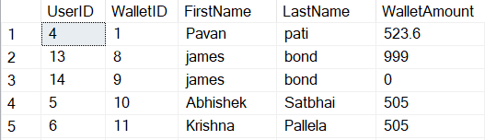
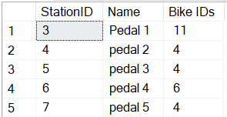
Views
# View for Wallet details of User
CREATE VIEW User_Wallet
AS
SELECT U.UserID, W.WalletID,
U.FirstName, U.LastName,
W.WalletAmount
FROM Users U
JOIN Wallet W
ON U.UserID = W.UserID
#View to report the availability of bikes at respective Stations
CREATE VIEW [Bike_Available]
AS SELECT DISTINCT B.StationID [StationID], S.Name,
STUFF((SELECT DISTINCT ', '+
RTRIM(CAST(BikeID AS CHAR))
FROM BikeStations BS
WHERE BS.StationID = B.StationID
AND BikeStatus ='Available'
FOR XML PATH('')) ,1, 1, '') AS 'Bike IDs'
FROM BikeStations B
INNER JOIN Stations S
ON S.StationID = B.StationID
User_Wallet
Bike_Available

Slide 11
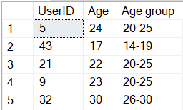
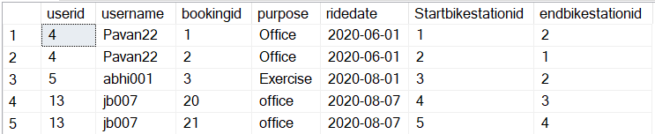
Views
# VIEW to categorise Age Groups for Reporting
CREATE VIEW CalculateAgegroup
AS
SELECT UserID, Age,
CASE
WHEN Age BETWEEN 14 AND 19 THEN '14-19'
WHEN Age BETWEEN 20 AND 25 THEN '20-25'
WHEN Age BETWEEN 26 AND 30 THEN '26-30'
WHEN Age BETWEEN 31 AND 40 THEN '31-40'
END AS [Age group]
FROM Users
# View for Logging Trips on each Booking for Users
CREATE VIEW User_Booking_Details
AS
SELECT U.UserID, U.Username, B.BookingID,
B.purpose, B.ridedate,T.StartBikeStationID,
T.EndBikeStationID
FROM Users U
JOIN Bookings B
ON U.UserID = B.UserID
JOIN Trips T
ON B.BookingID = T.BookingID
CalculateAgeGroup
User_Booking_Details

Slide 12
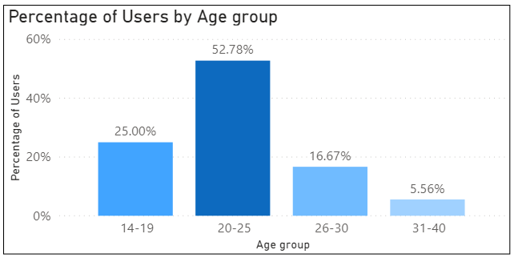
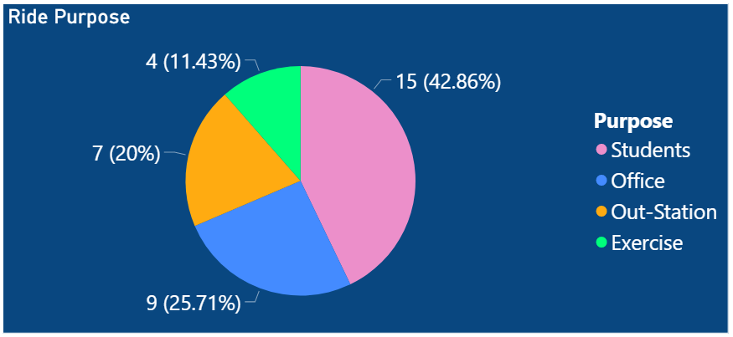
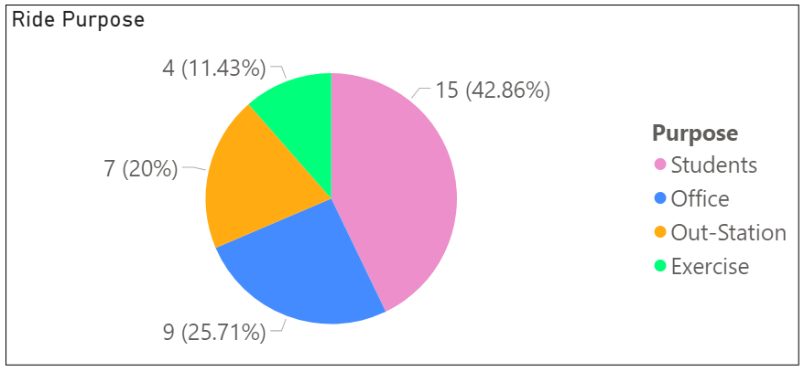
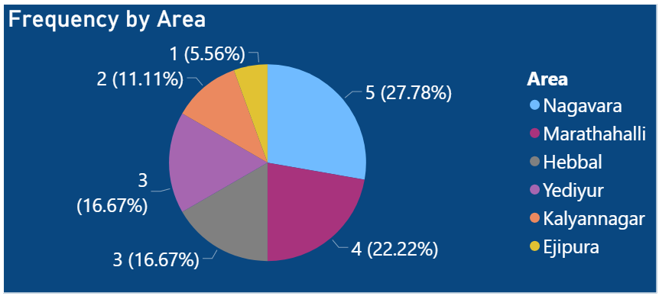
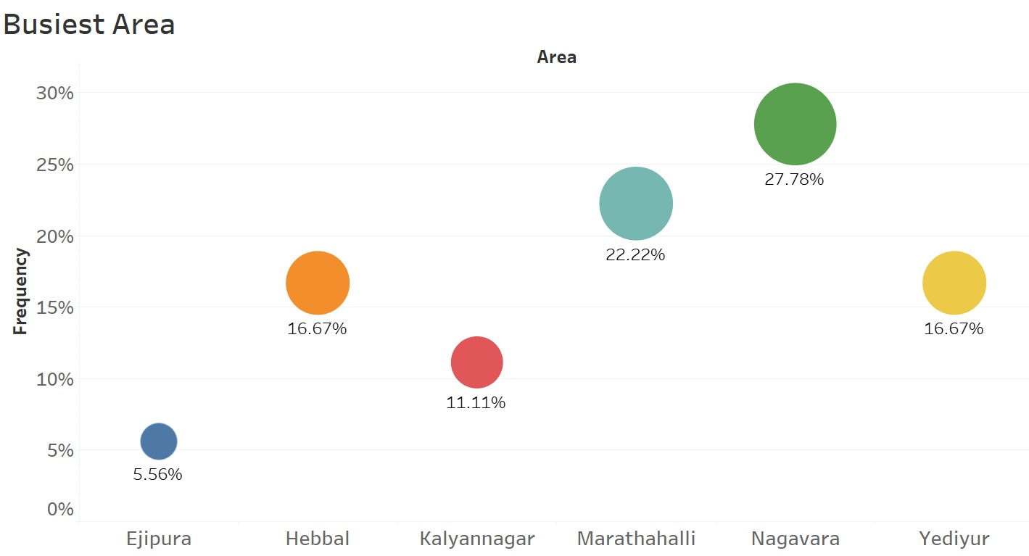
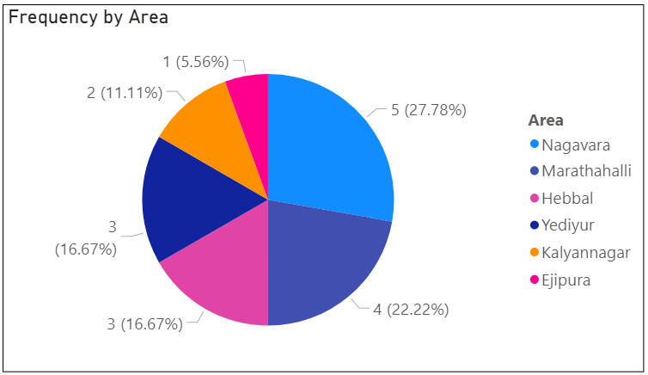
Analytics

Slide 13
Thank you
Q/A

